Slide 1
Engineering Requirement Software Electricity faults

Slide 2
Define the problem
The occurrence of an electrical fault in the house, the electrician not responding to the phone, or not knowing the numbers of the electricians
Electrical appliances play a crucial role in our daily lives, but they often require regular maintenance to operate at their best. Unfortunately, many individuals and businesses neglect or lack the knowledge to properly maintain their electrical devices. This leads to reduced lifespan, safety hazards, and inefficient performance, resulting in costly repairs or replacements. Therefore, there is a need for a professional electrical appliance maintenance service that addresses these concerns.

Slide 3
Vision Document
Our vision is to establish a comprehensive electrical appliance maintenance service that ensures the longevity, safety, and optimal performance of electrical devices for both residential and commercial customers. We aim to be recognized as the go-to provider for reliable and efficient electrical appliance maintenance, fostering customer trust and satisfaction.

Slide 4
SRS Document
2.1 Functional Requirements
2.2 Functional Non-Requirements
2.3 Glossary

Slide 5
Functional Requirements
User Management:User registration and login system for customers to access maintenance services.User profiles to store customer information, service history, and preferences.
Appointment Scheduling:Online booking system to allow customers to schedule maintenance appointments.Availability calendar to display technician availability for different time slots.Automatic confirmation and reminder notifications for scheduled appointments.
Device Registration:Ability for customers to register their electrical appliances in their user profiles.Capture appliance details such as make, model, serial number, and purchase date.
Inspection and Diagnosis:Conduct thorough inspections of registered appliances for potential issues.Utilize diagnostic tools to identify problems accurately.Generate inspection reports detailing the condition of the appliance and recommended actions.
Maintenance Services:Cleaning and dust removal to prevent overheating and improve performance.Testing and calibration of electrical components for accurate functionality.Replacement of worn-out parts and repairs as needed.Upgrades and enhancements to improve energy efficiency and usability.
afety ChecksS:Conduct safety checks to identify and rectify potential electrical hazards.Verify proper grounding, wiring integrity, and adherence to safety regulations.Install and test safety devices such as surge protectors and smoke detectors.
Service History and Tracking:Maintain a comprehensive service history for each appliance, including maintenance dates, performed actions, and results.Provide customers with access to their service history for reference and tracking purposes.
Notifications and Reminders:Send regular maintenance reminders to customers based on appliance usage and recommended maintenance intervals.Notify customers of upcoming appointments, technician arrival, and service completion.

Slide 6
Functional Non-Requirements
Physical Repair of Appliances:The maintenance service does not include physical repairs of appliances beyond the scope of regular maintenance, such as major component replacements or extensive repairs requiring specialized expertise.
Appliance Sales:The service does not involve the sale of new or used electrical appliances. It focuses solely on the maintenance and upkeep of existing appliances.
Appliance Installation:The service does not include appliance installation or setup. It is solely focused on the maintenance and performance optimization of already installed appliances.
Warranty Claims:The service does not handle warranty claims or provide warranty services for appliances. Customers should contact the manufacturer or authorized service centers for warranty-related issues.

Slide 7
Glossary
Definitions of maintenance of electrical appliances:
1. Maintenance: These are the operations aimed at preserving electrical appliances and correcting any defects or malfunctions that occur in them.
2. Electrical appliances: They are appliances that operate with electricity, such as refrigerators, air conditioners, washing machines, televisions, electric ovens, and others.
3. Preventive maintenance: It is the operations that are carried out for electrical appliances regularly, in order to maintain the equipment in good condition and avoid the occurrence of any defects or malfunctions.
4. Periodic maintenance: operations that are carried out on a regular basis according to a specific schedule, and include cleaning and checking the internal and external parts of electrical appliances.
5. Corrective maintenance: It is the operations that are carried out to repair faults and defects that occur in electrical devices, and it includes replacing damaged parts and fixing software errors.

Slide 8
Solve the problem
Creating software that makes the customer send the problem to the electricity maintenance company, and the electricity maintenance company communicates with the customer, and a maintenance employee is sent to solve the customer's electricity problem.

Slide 9
Use Case Model
Use Case Diagram
Use Case Descriptions

Slide 10
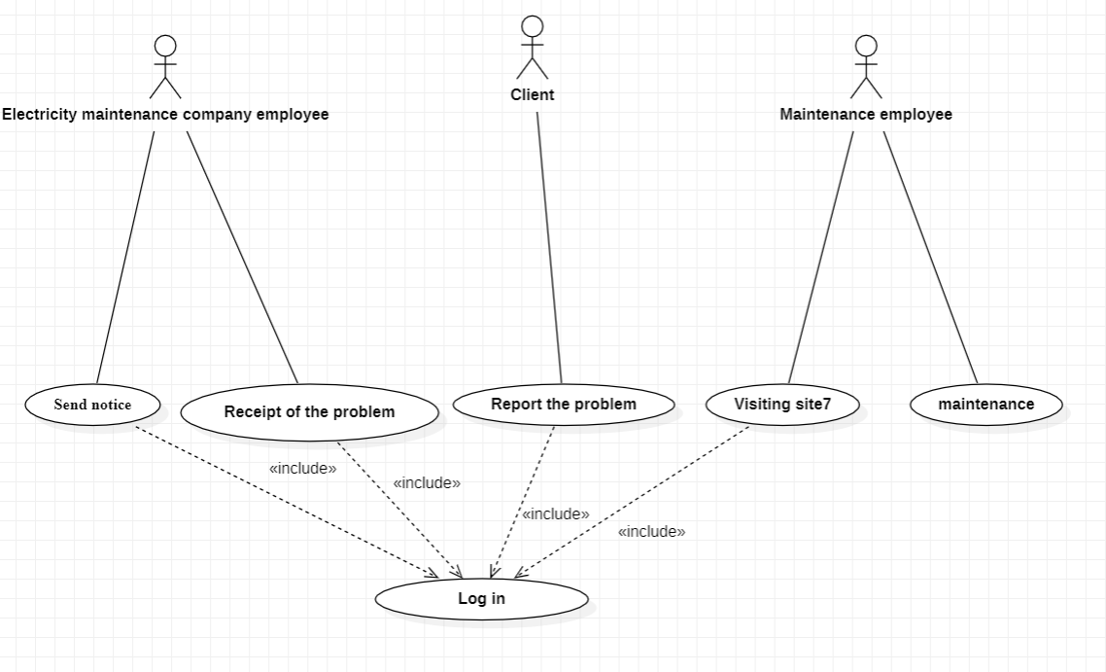
Use case model

Slide 11
description
login | Usecase name
موظف شركة صيانة الكهرباء, موظف الصيانة، العميل Electricity maintenance company employee, maintenance employee, customer | actors
ان يكون مسجل في الموقع To be registered on the site | Precondition
العميل يفتح الموقع يسجل الدخول عليه 3. موظف شركة الكهرباء يدخل على الموقع 4. يسجل الدخول على الموقع 5. موظف الصيانة يدخل على الموقع 6. يسجل الدخول على الموقع The customer opens the site.1 log on it.2 3. An employee of the electricity company enters the site 4. Log in to the site 5. The maintenance employee enters the site 6. Log in to the website | Flow of event
إتمام عملية تسجيل الدخول Complete the login process | Postcondition
ادخال اسم المستخدم وكلمة المرور صحيحة Enter the correct username and password | Quality requirements

Slide 12
